Slide 2
Literary criticism helps interpret the meaning of a short story, poem, or play.
It is an attempt to understand and evaluate what the author has created.

Slide 3
Literary criticism of a work usually offers:
interpretation of its meaning
analysis of its structure and style
judgement of its worth by comparison with other works
estimation of its likely effect on readers

Slide 4
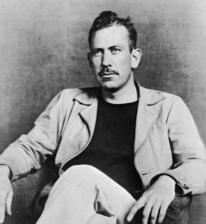
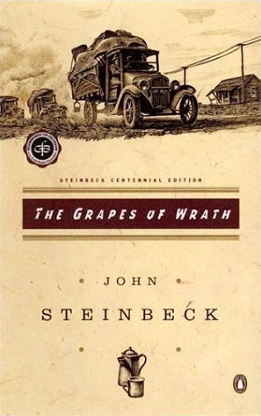
Literary criticism can apply to:
a genre
an author’s writings as a whole
a specific literary work

Slide 5
Where can I find literary criticism?

Slide 6
www.rphslibrary.org/databases

Slide 7
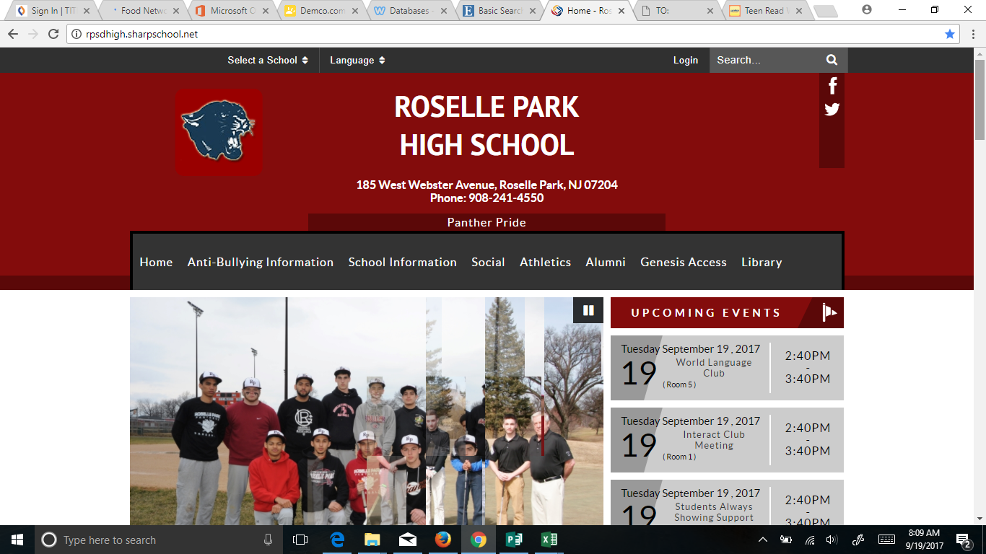
You can also find the library website from the high school website

Slide 8
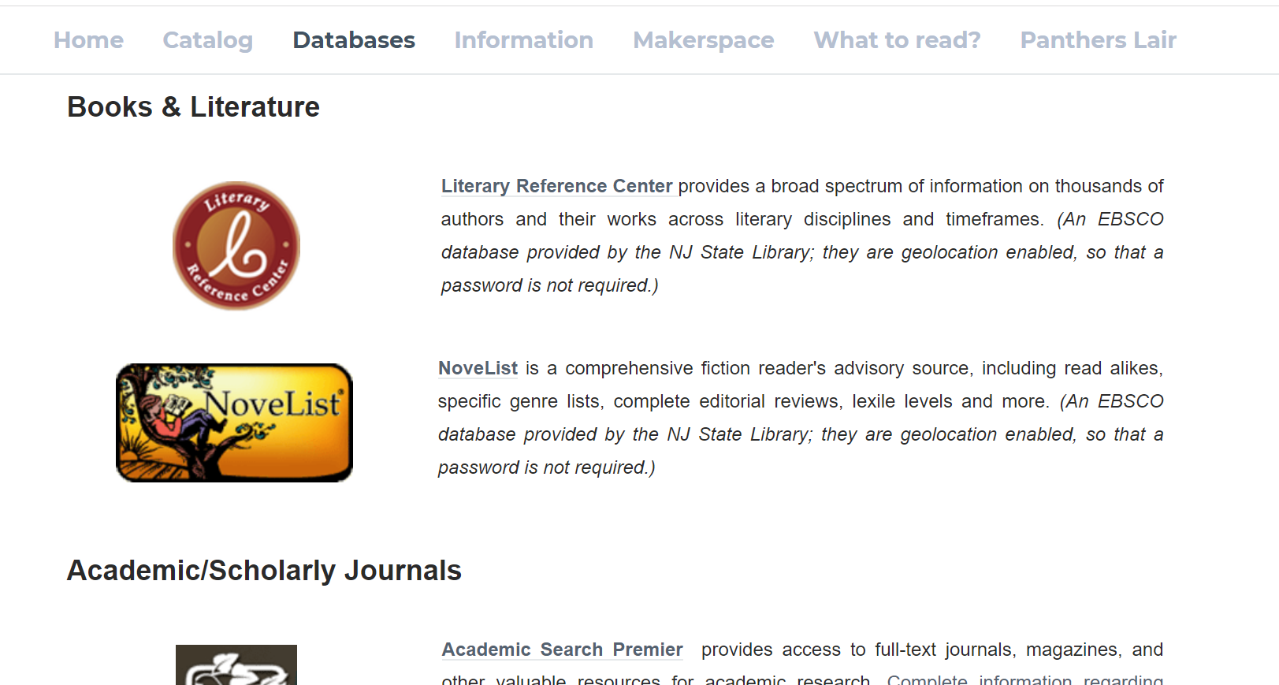

Slide 9
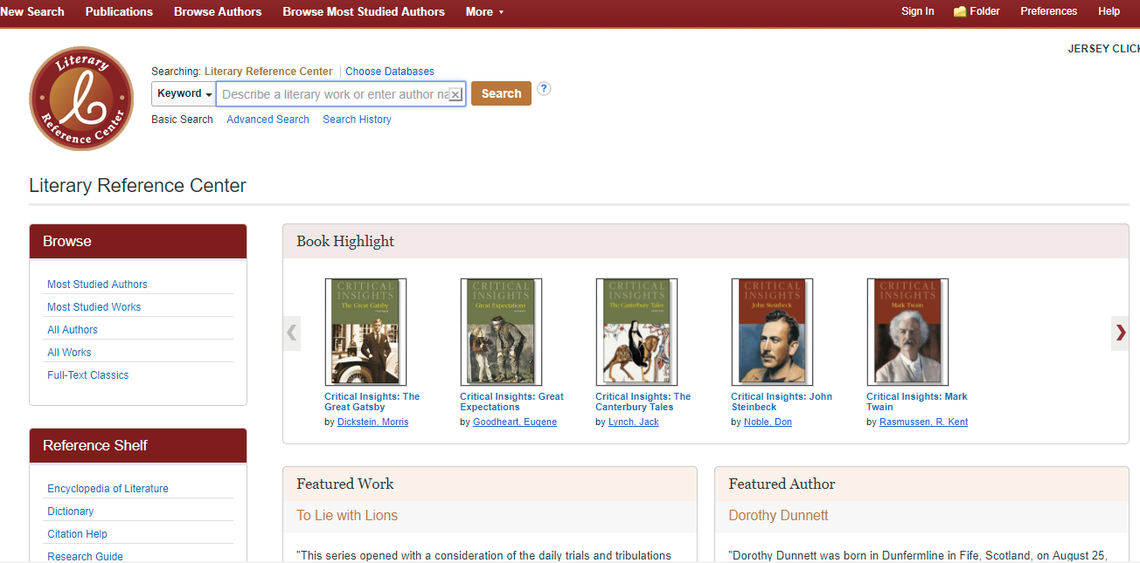

Slide 10
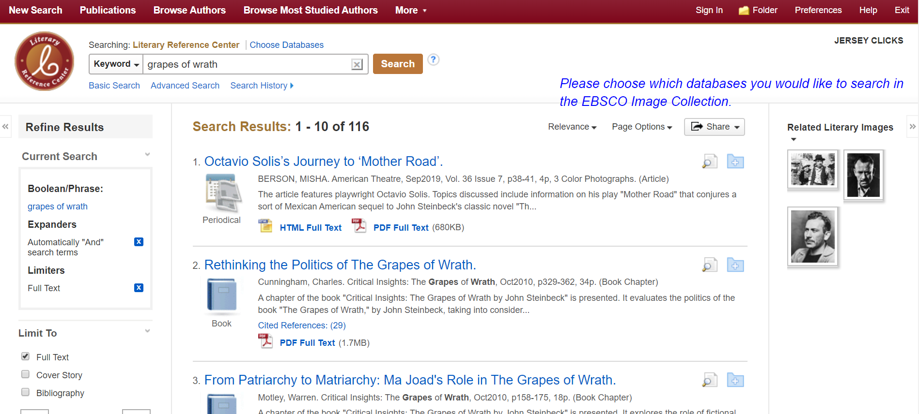

Slide 11
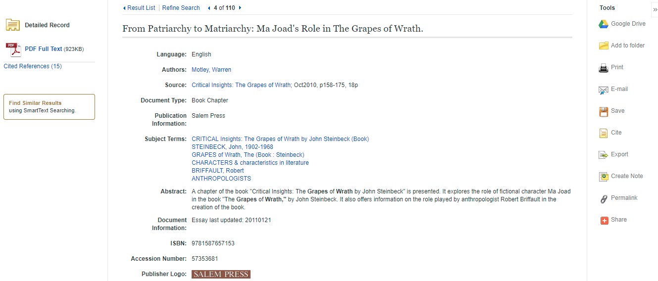

Slide 12
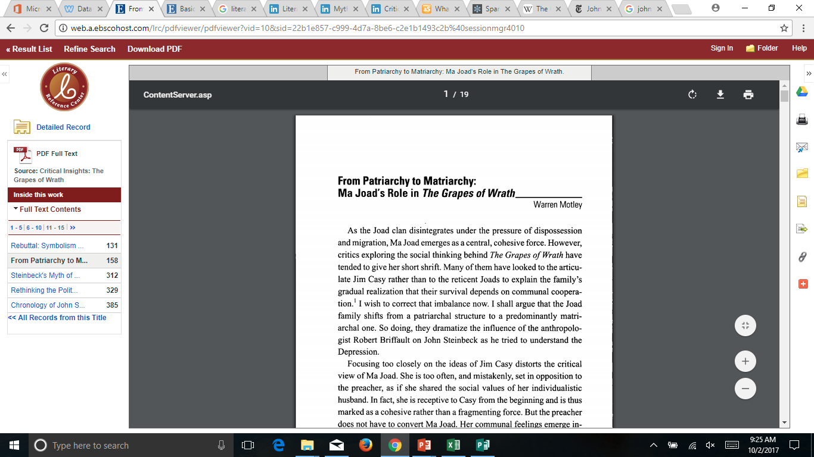

Slide 13
Download
Citation Tool

Slide 14
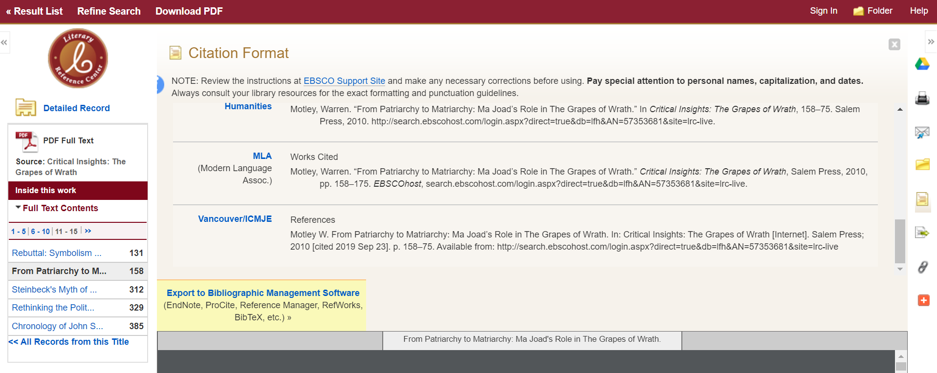

Slide 15
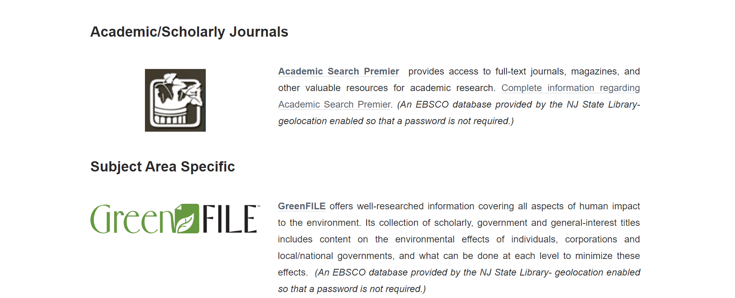

Slide 16
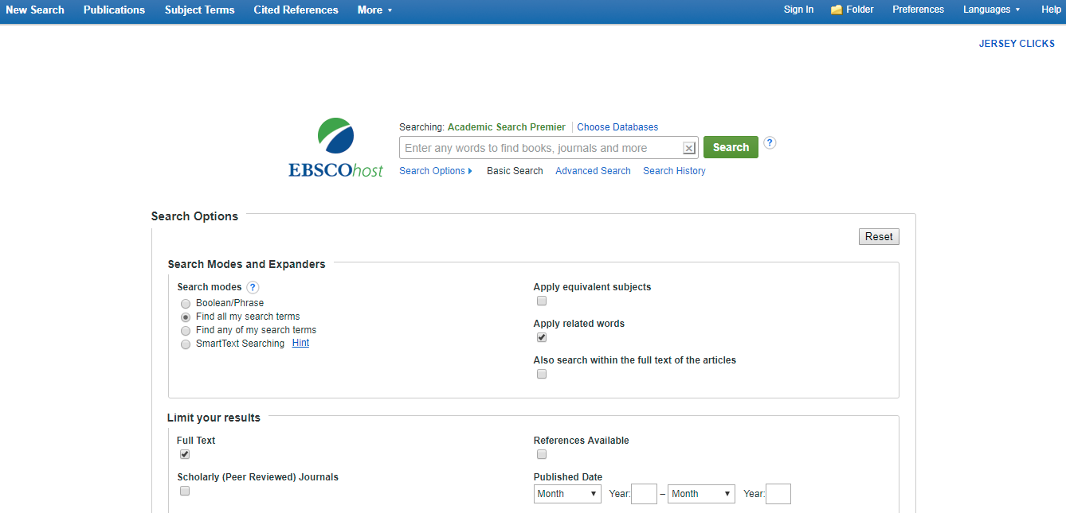
Be sure to check off Full Text to avoid disappointment!

Slide 17
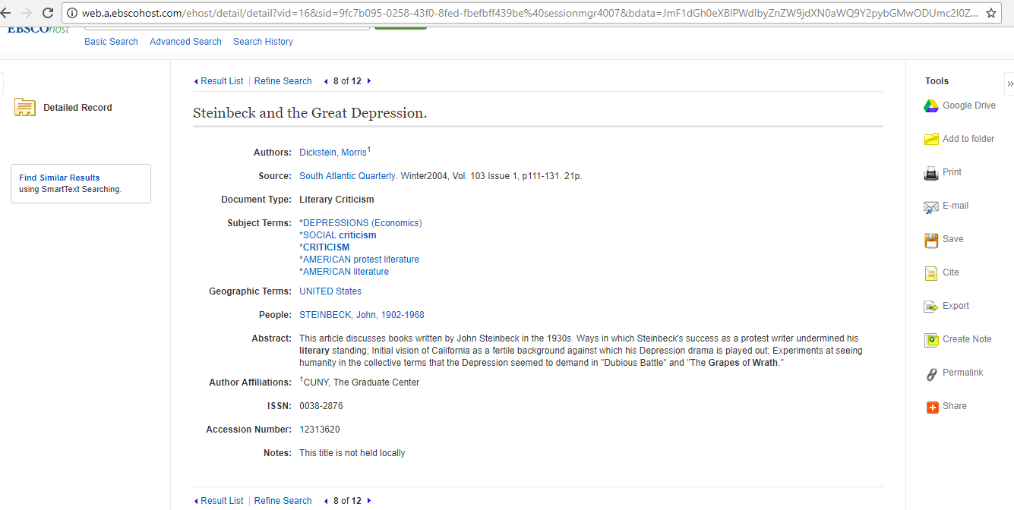
Only the abstract is available

Slide 18
Scroll down to limit your search
(on left side)

Slide 19
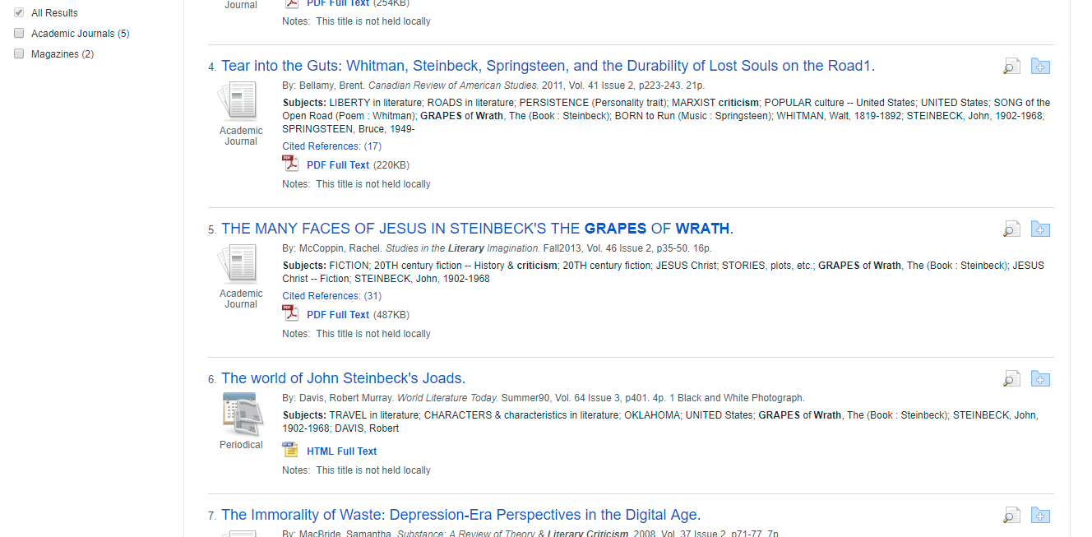

Slide 20
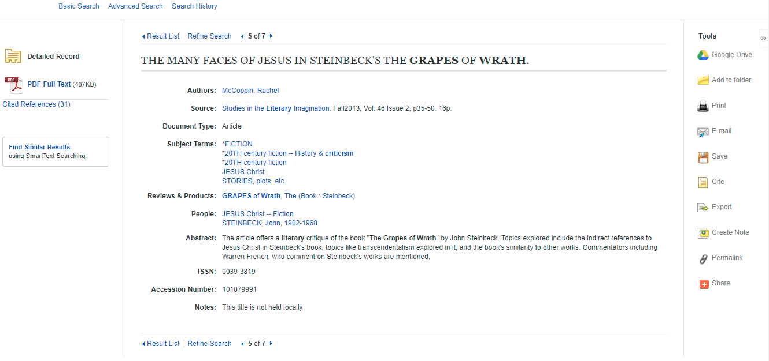

Slide 21
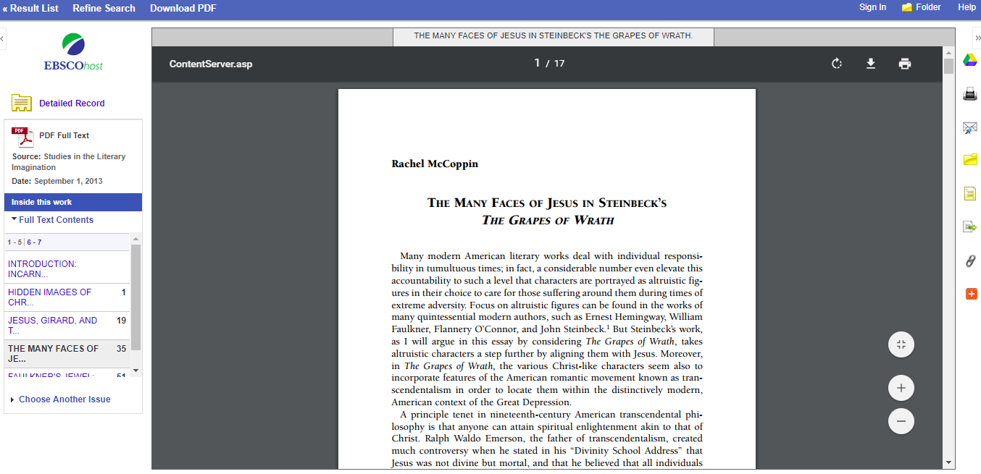

Slide 22
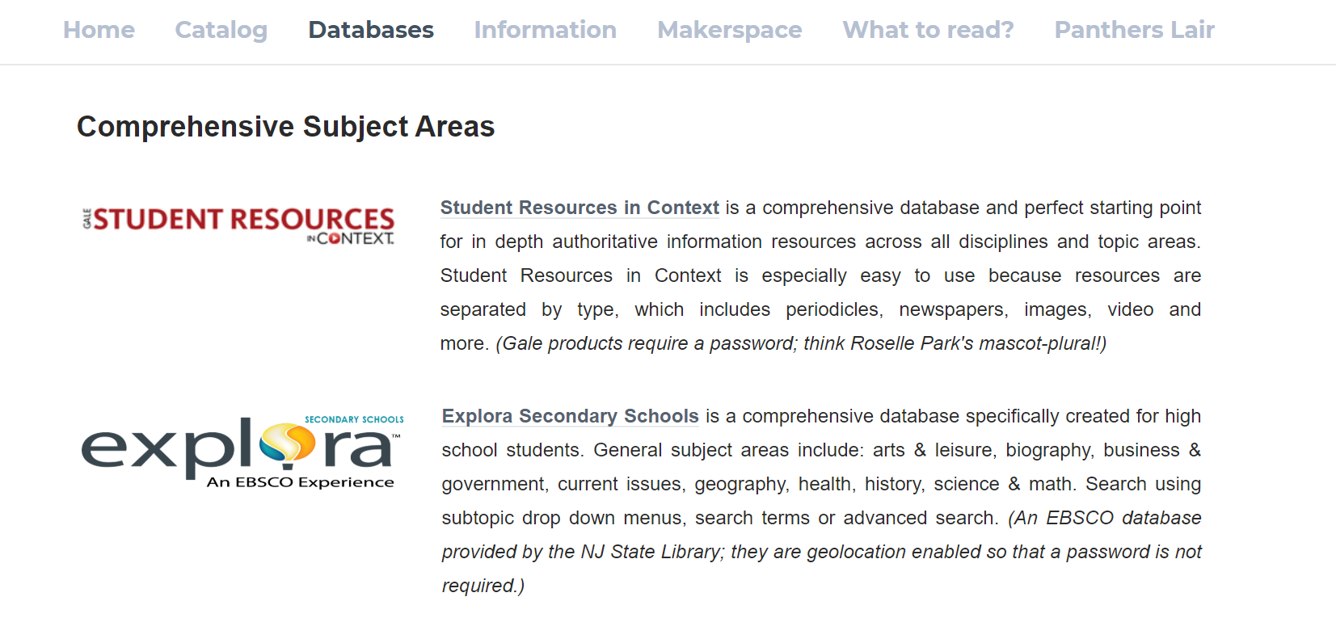

Slide 23
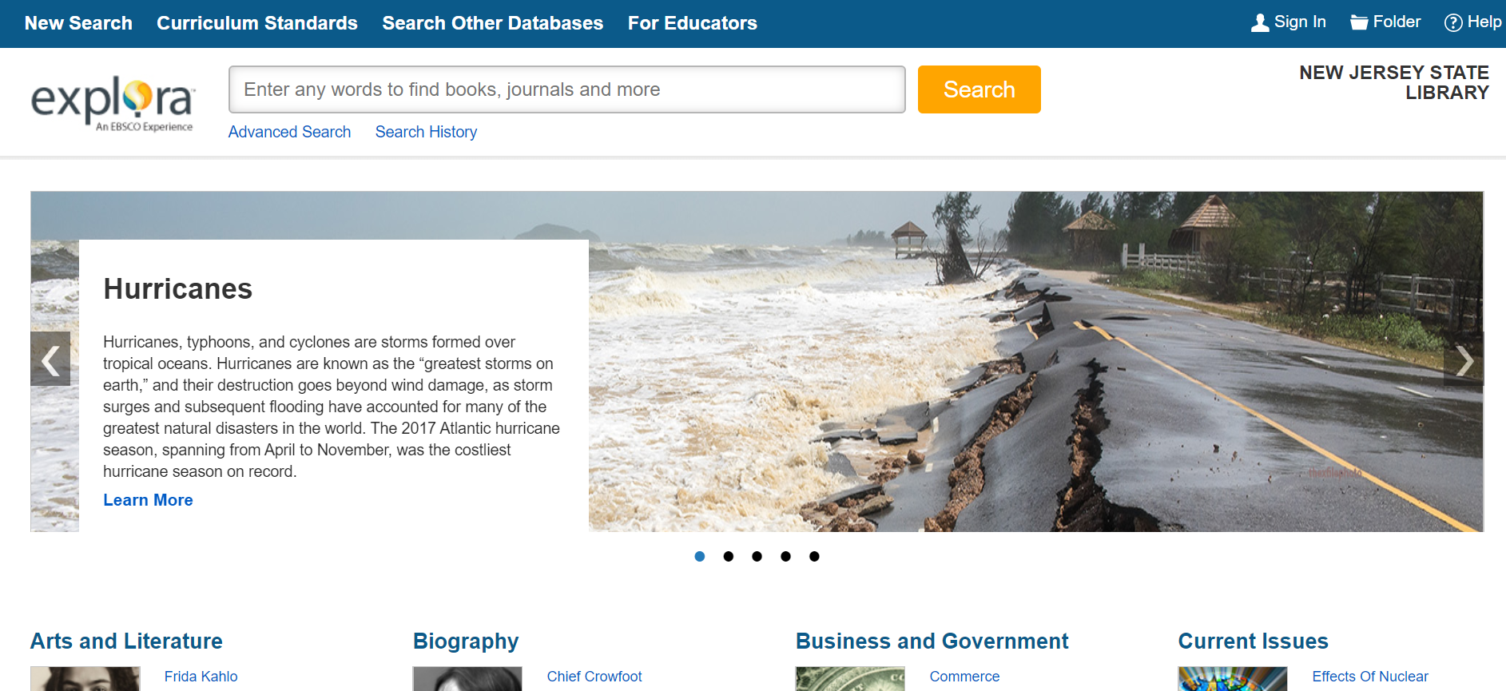

Slide 24
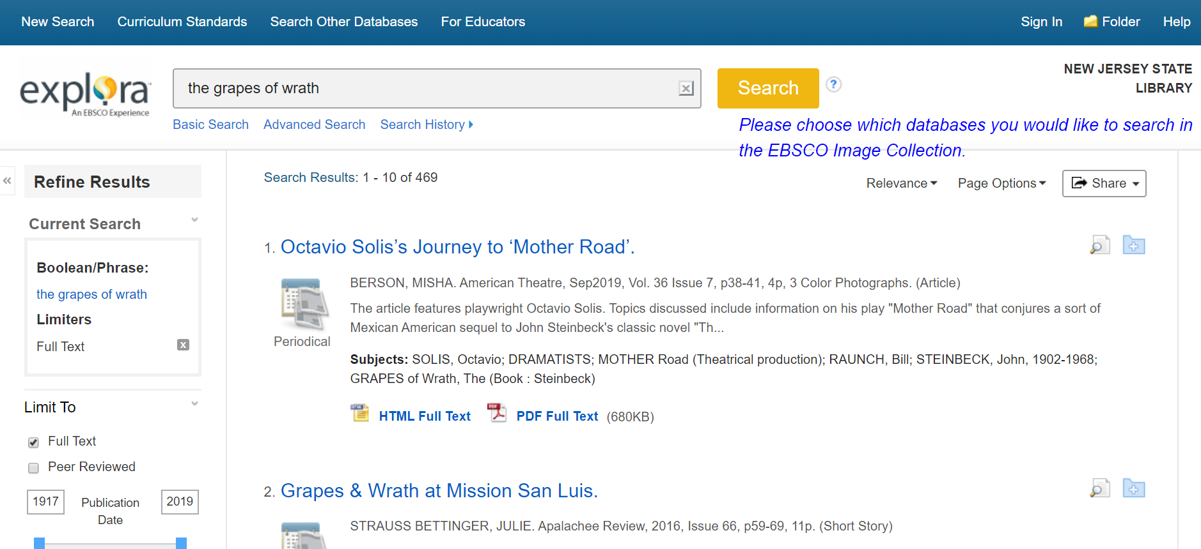

Slide 25
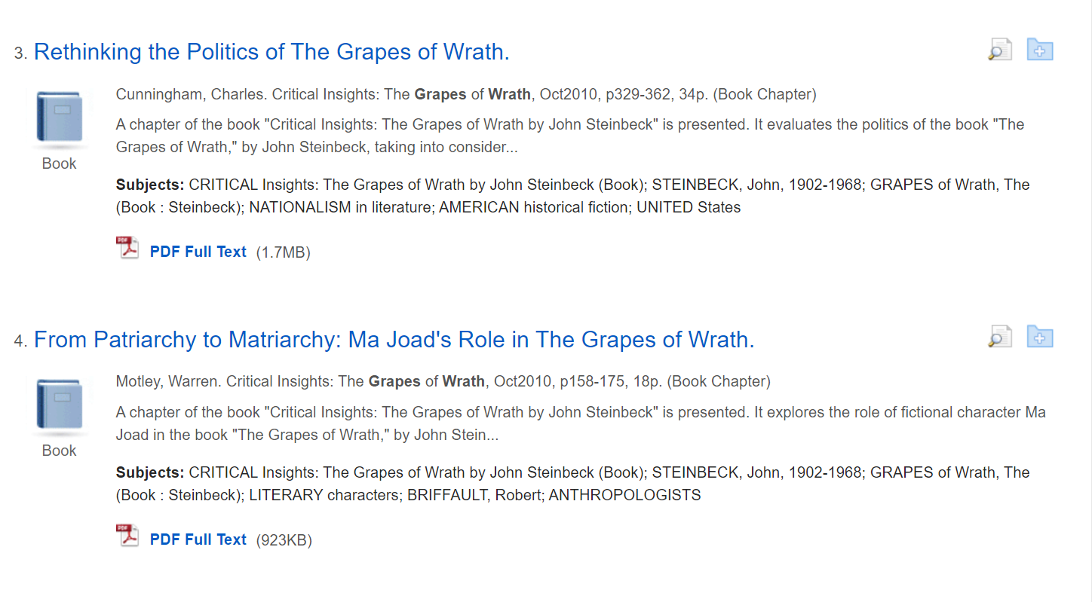

Slide 26
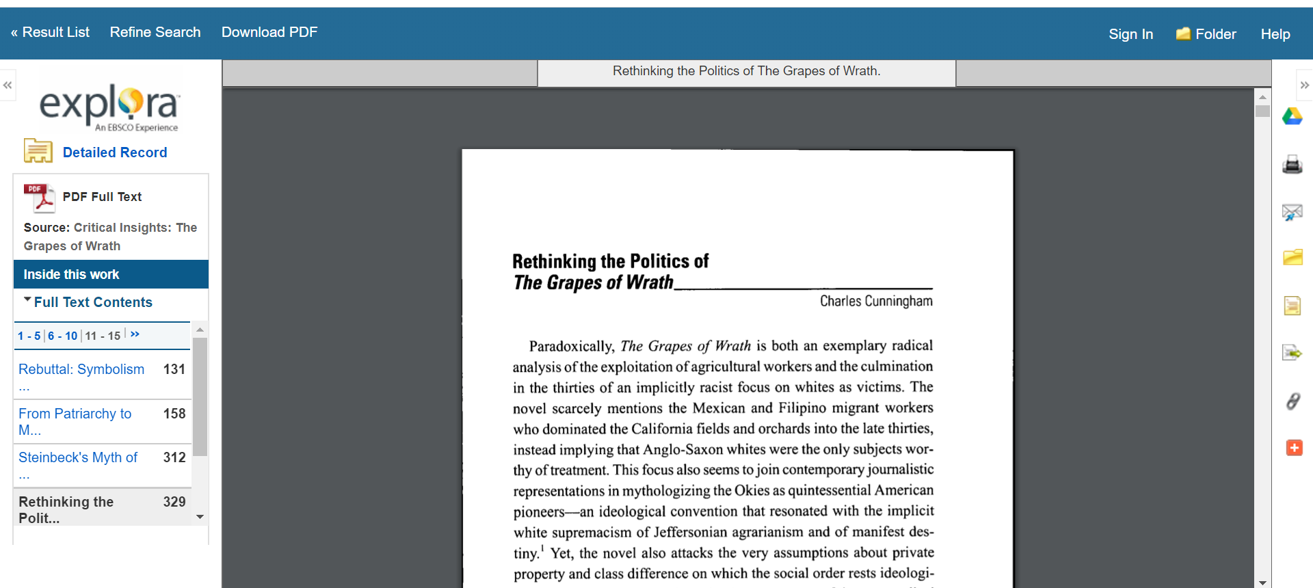

Slide 27
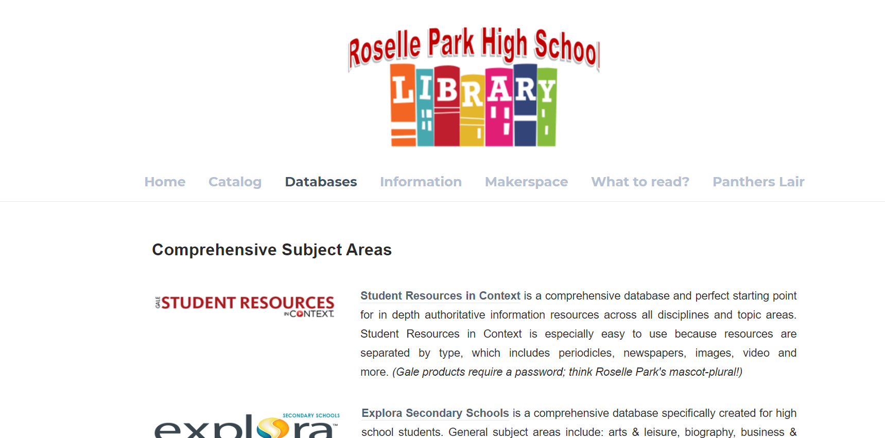

Slide 28
panthers

Slide 29
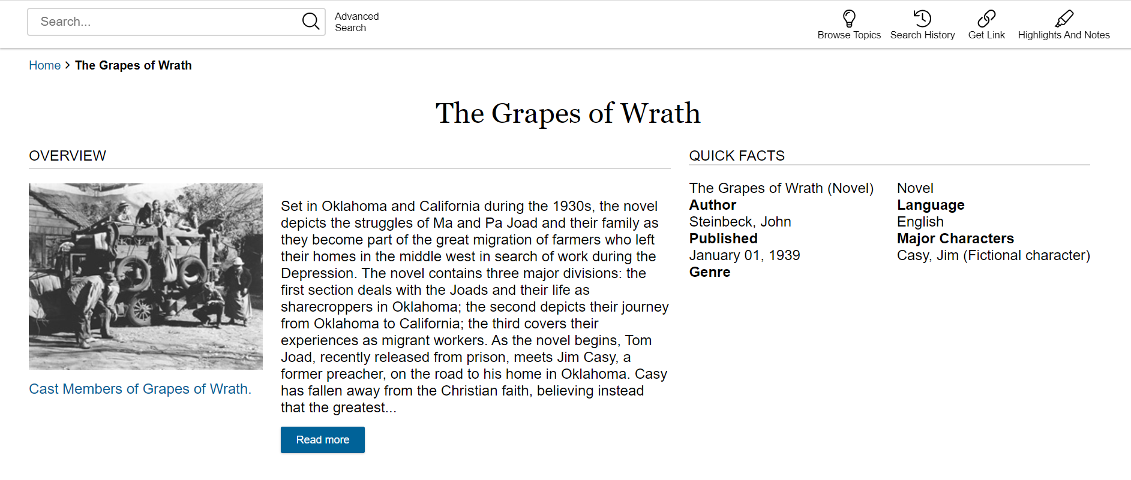

Slide 30
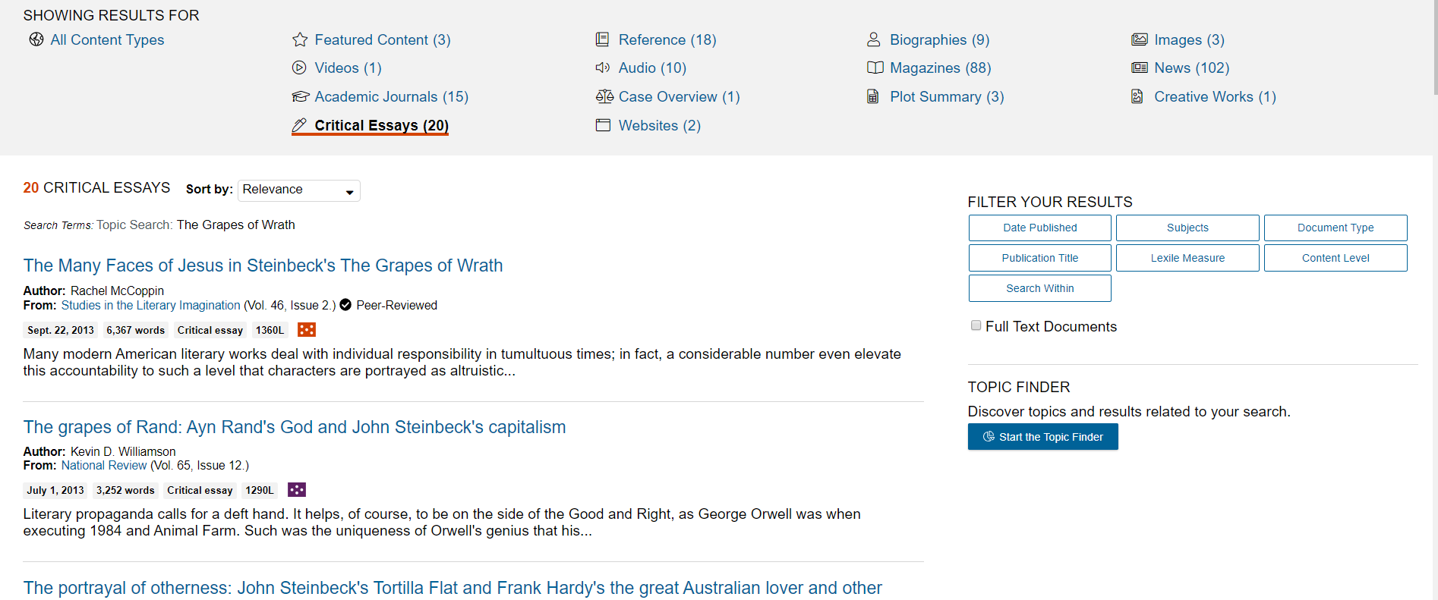

Slide 31
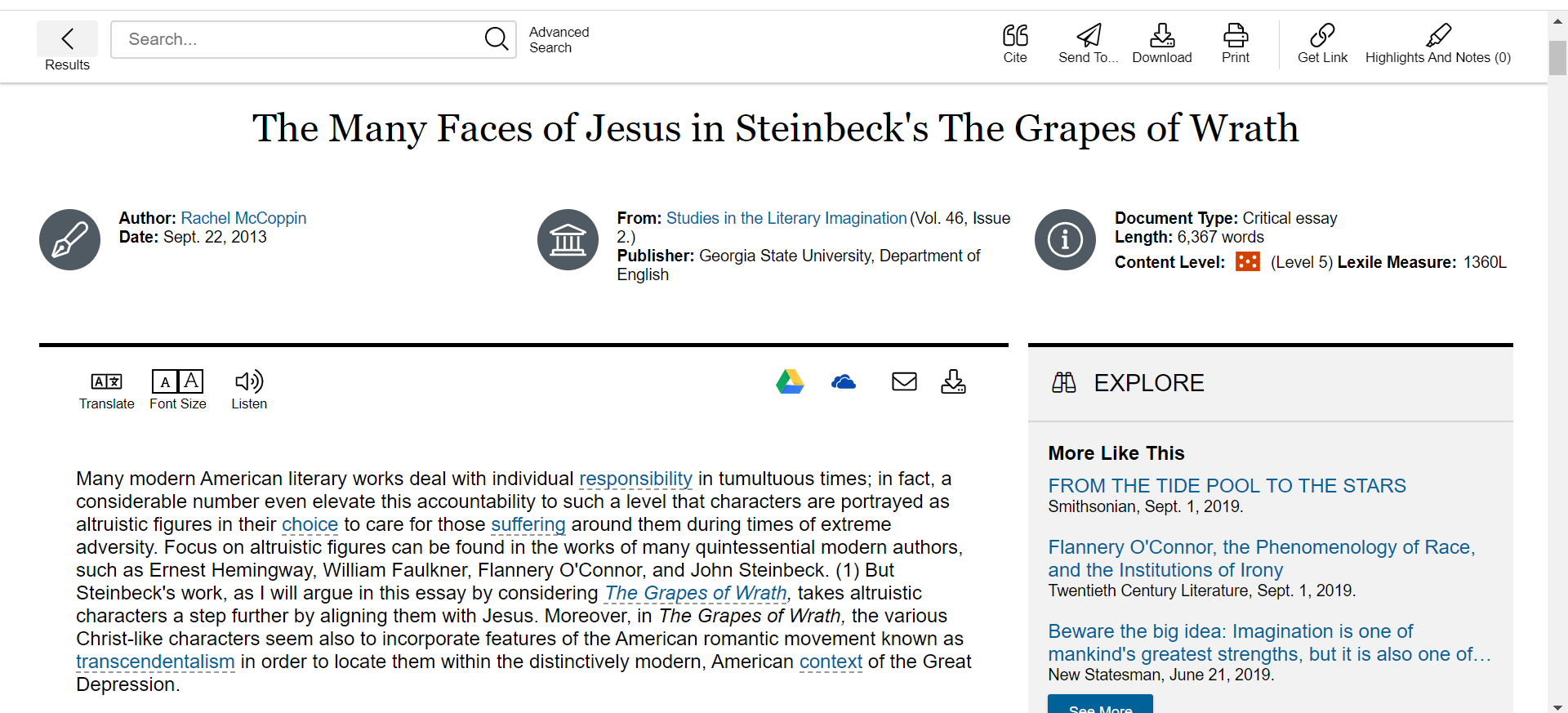

Slide 32
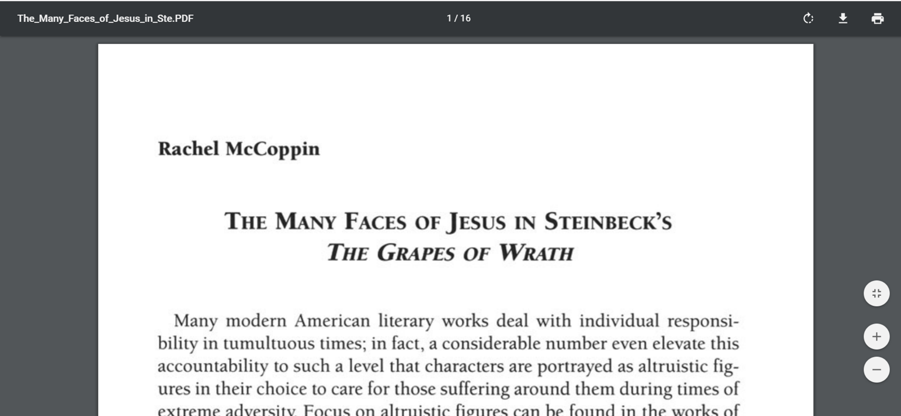

Slide 34
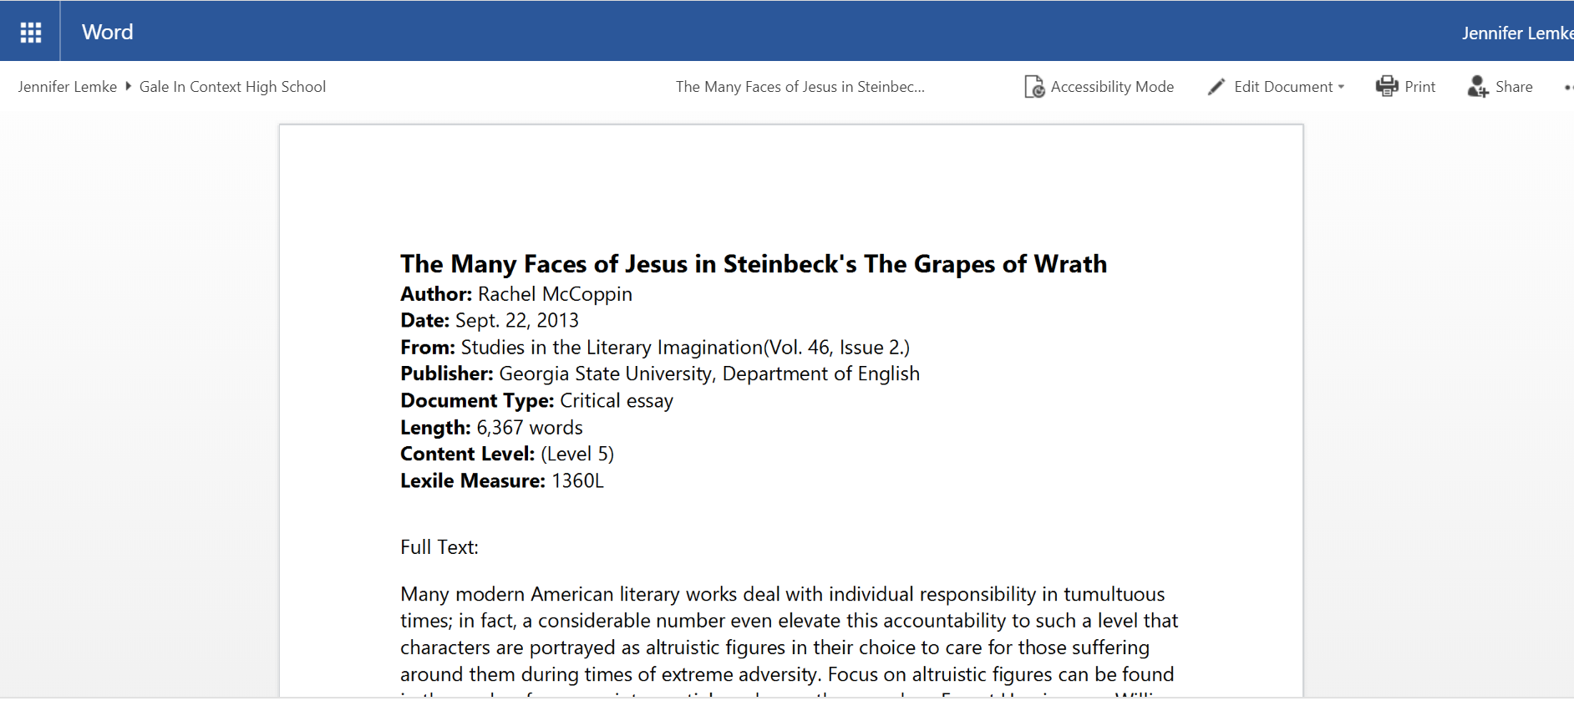

Slide 36
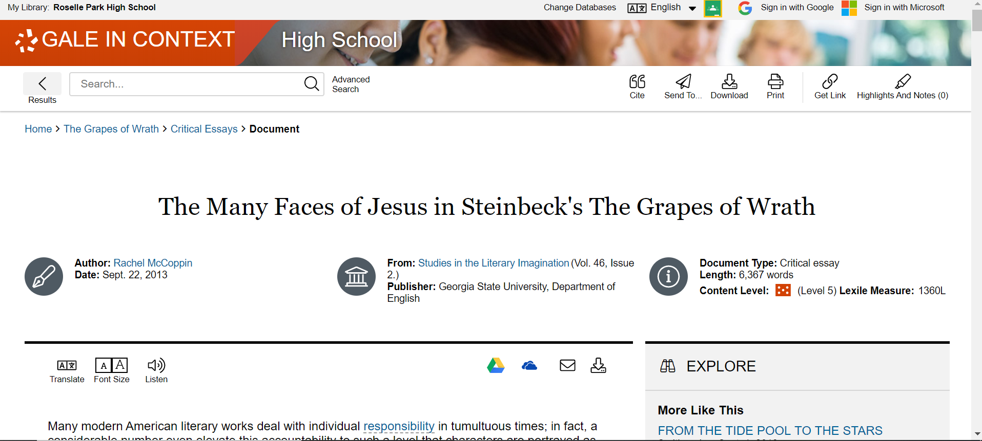

Slide 37
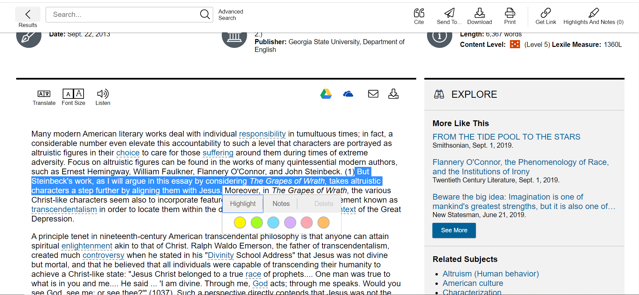

Slide 38
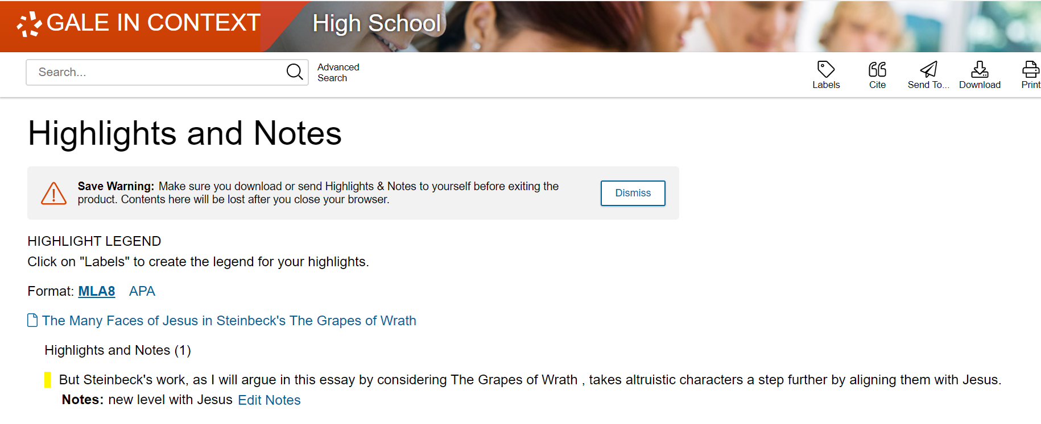

Slide 39
BOOKS!

Slide 42
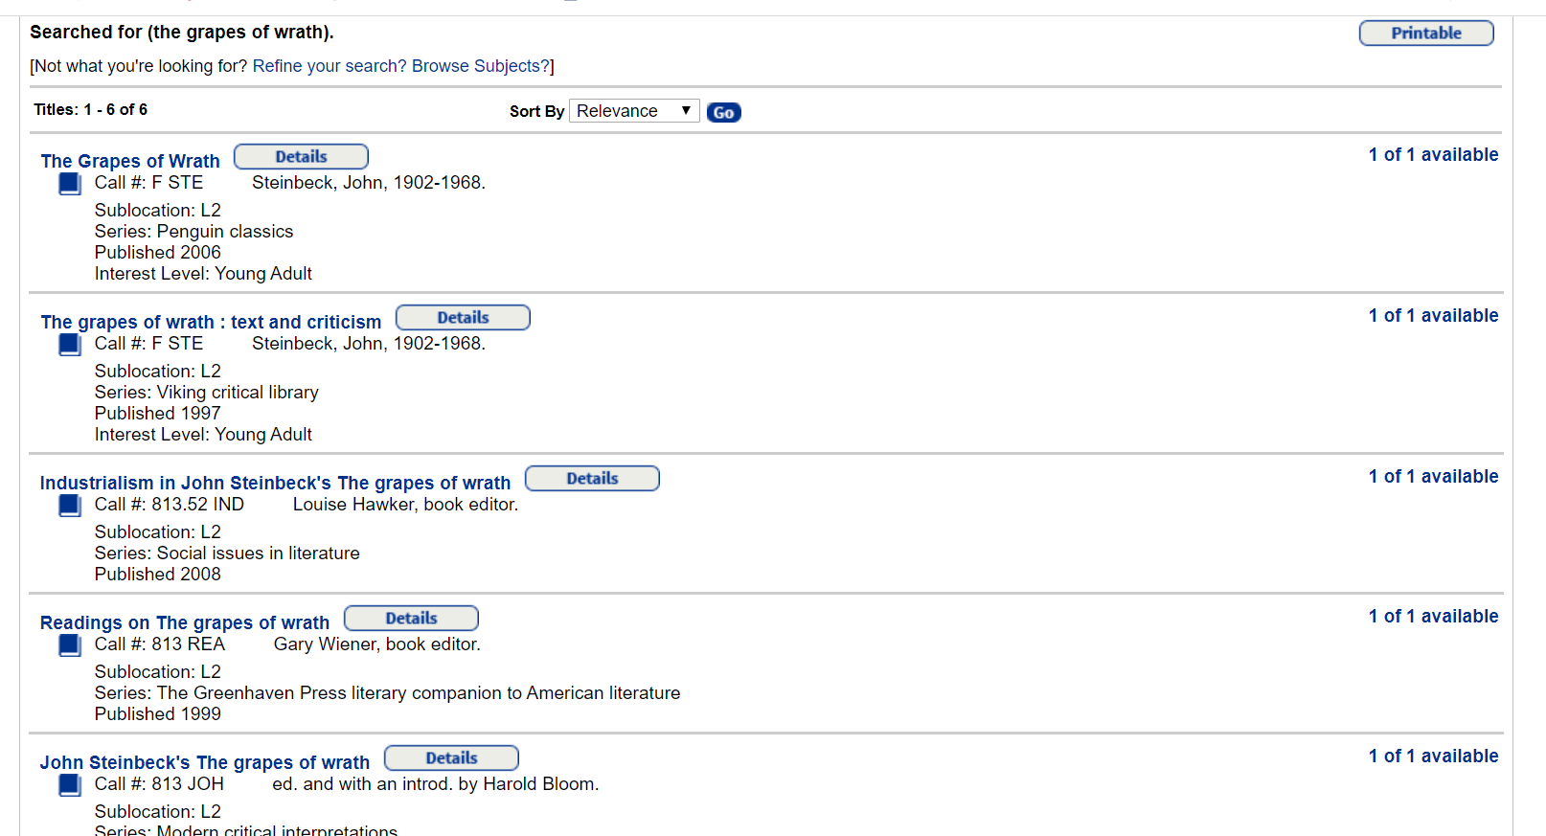
To find the book look at Call #

Slide 43
Going beyond the basic search
Brainstorm different search terms that are relevant to your topic (or to the novel if you are not sure of your topic yet)

Slide 45
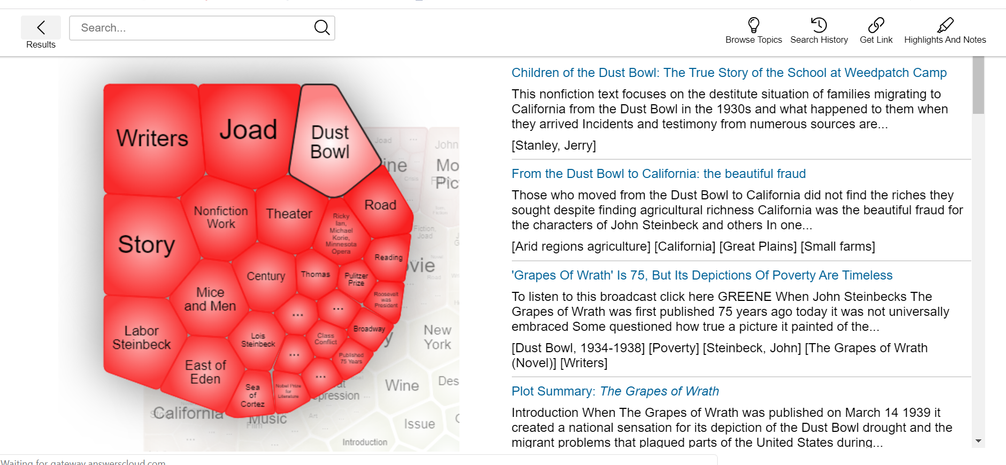

Slide 46
Questions? Need help?
Email Ms. Lemke at jlemke@rpsd.org or stop by the library.

